Slide 1
English Project :
Pokelearning
Mathieu Dreyer, Antoine Jacque, Quentin Millardet

Slide 2
METHODOLOGY USED
01
TECHNICAL FEATURES
02
FEEDBACKS
03
CONCLUSION
04
Time gestion and work charge repartition
Overview of used technologies
What we improved during this project
What we're holding back and what can be improved!

Slide 3

00
Introduction
Aim on ergonomics

Slide 4

01
Methodology used
The art of organisation

Slide 5
A TIMELINE ALWAYS WORKS WELL
Creation of the question-answer system
01
Creation of the programming backbone and routing
02

Slide 6
A TIMELINE ALWAYS WORKS WELL
Question management
04
Make Pwa and putting the application online
03

Slide 7

02
TECHNICAL FEATURES
Used technologies overview

Slide 8


VueJS
A Javascript open-source framework
SPA (Single Page Application)
React graphic component and packable component

Slide 9
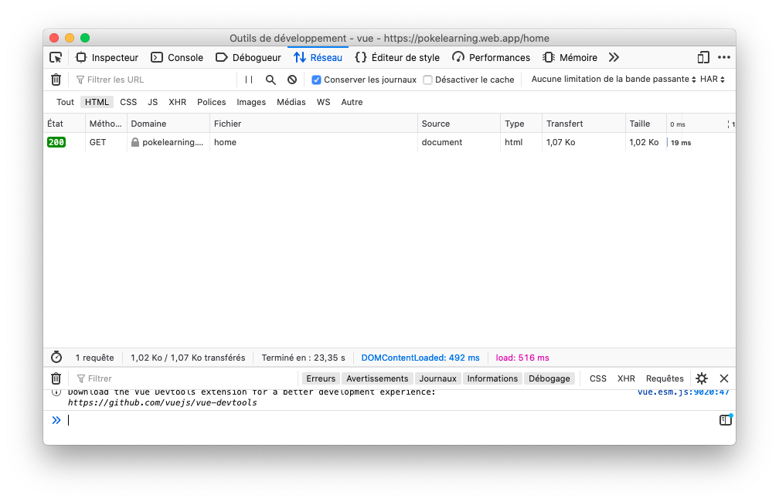
VueJS : SPA (Single Page Application)
Only one load from the server
Client-side modification by script
Can be used offline after a single charge

Slide 10

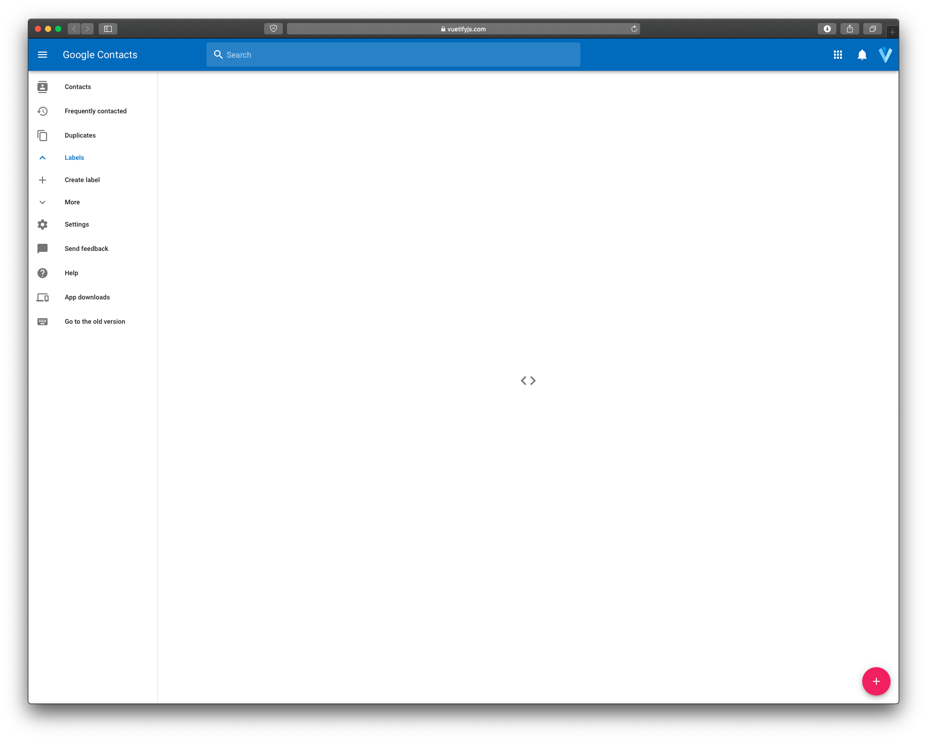
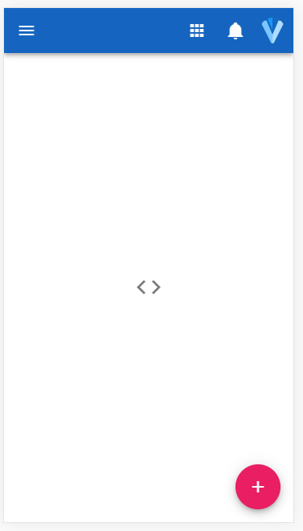
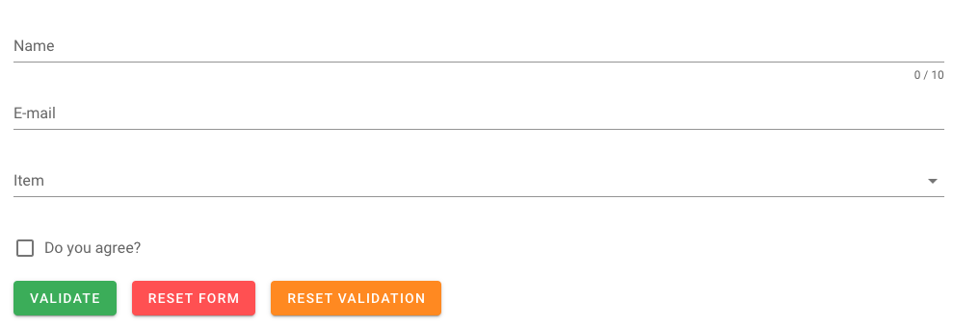
VueJS plugin : Vuetify
Add graphic component
Style based on Material Design
Manage easily forms

Slide 11
VueJS plugin :
Vue-router
/
Render dynamic an application
Navigation generate by script
Define route for a component
Define a redirection or action before going to a link
/home
/newQuestion
/battle

Slide 12
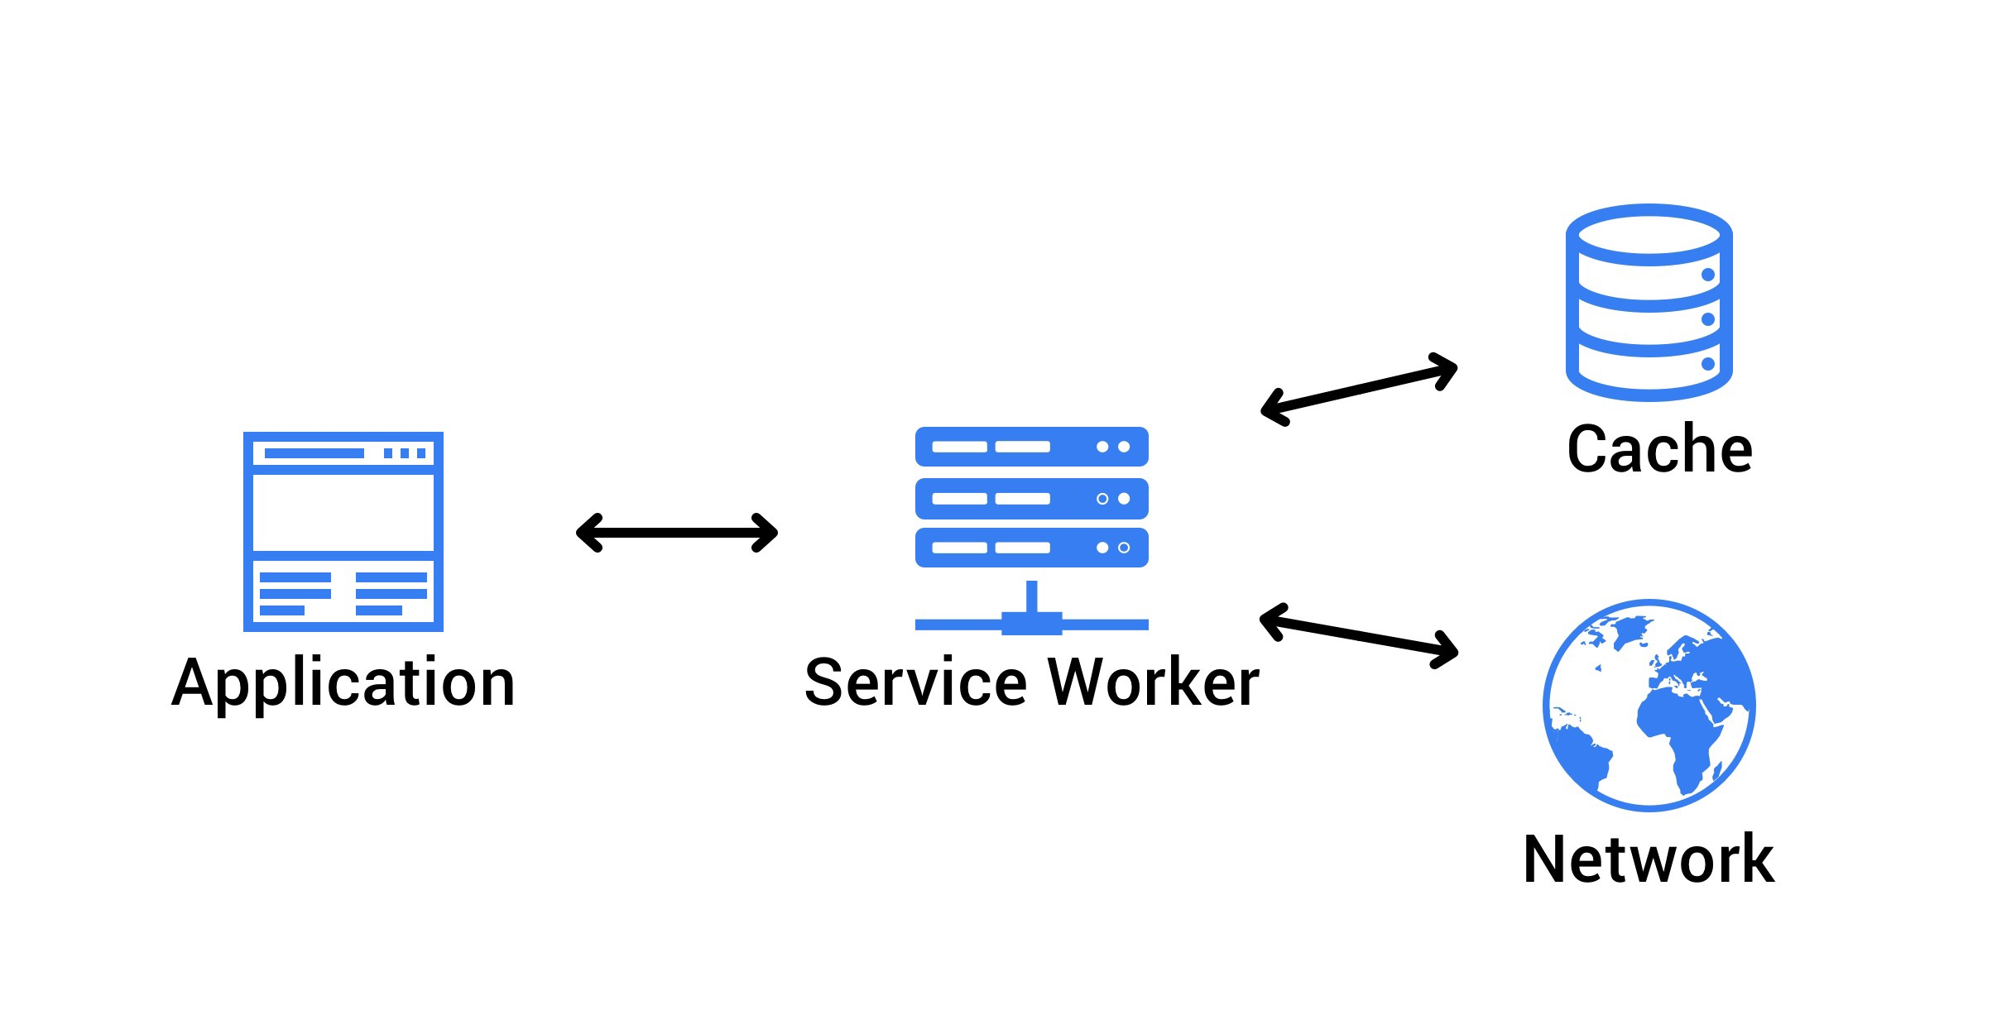
WebApp as normal app
Progressive Web App
Service Worker
Installable
Quickly accessible
No download
Background task
Cache management
Control network request

Slide 13
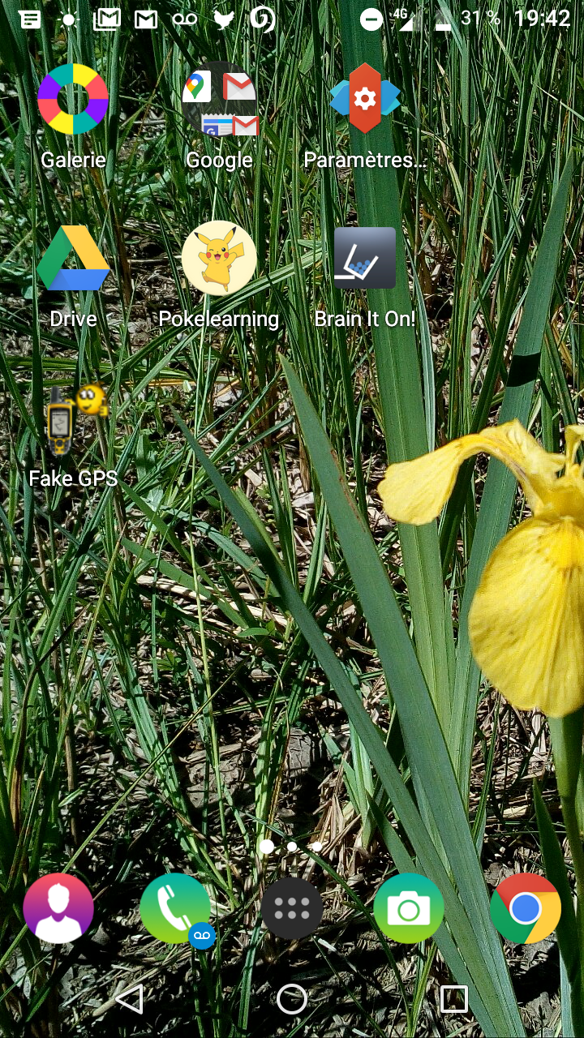
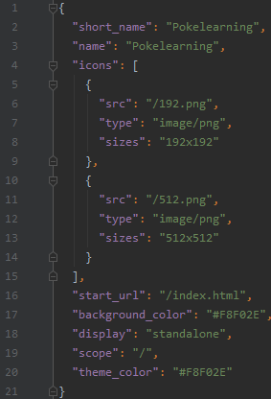
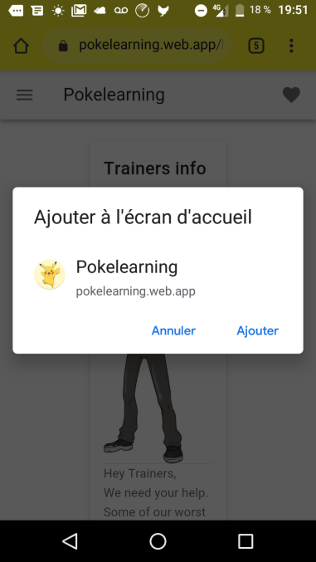
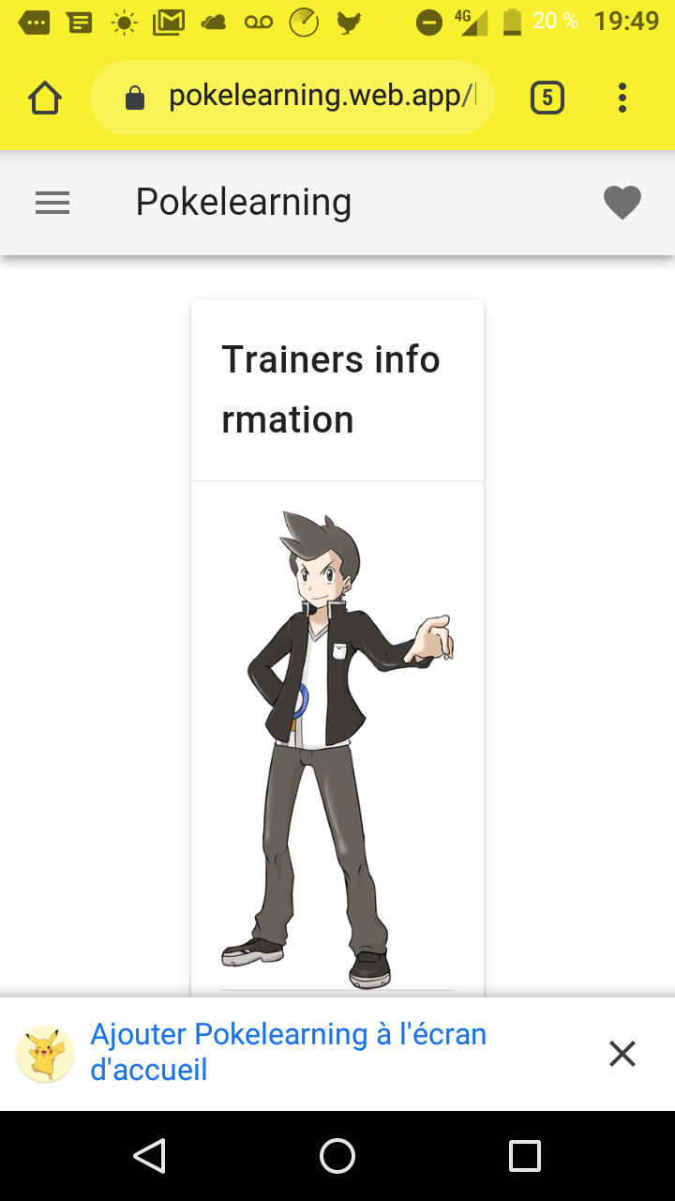
The web app manifest

Slide 14
IndexedDb
Or how to store data
Store locally
Quick access
Offline storage and access
Fast search and indexing possibility
Lockless
Easy to use
Background tasks to avoid blocking main script
Define the

Slide 15
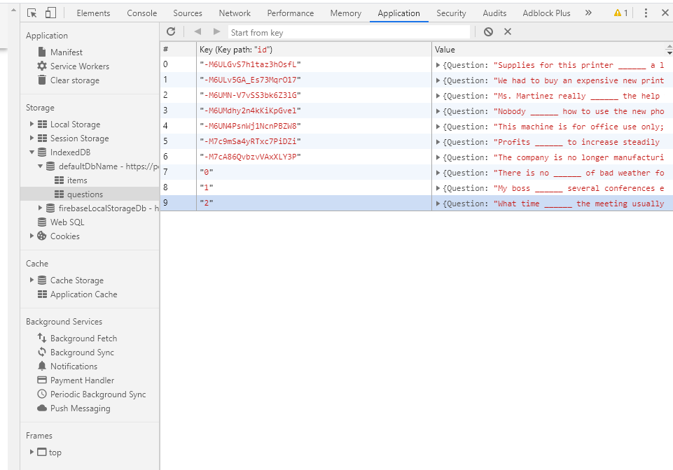
IndexedDb
Security aspect
Accessible
Modifiable
Different on each client

Slide 16

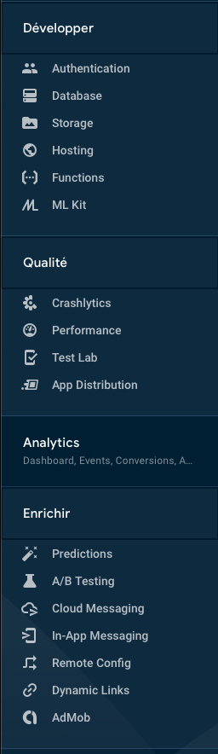
Firebase
Google Hosting platform
A lot of tool
Free for basic usage

Slide 17
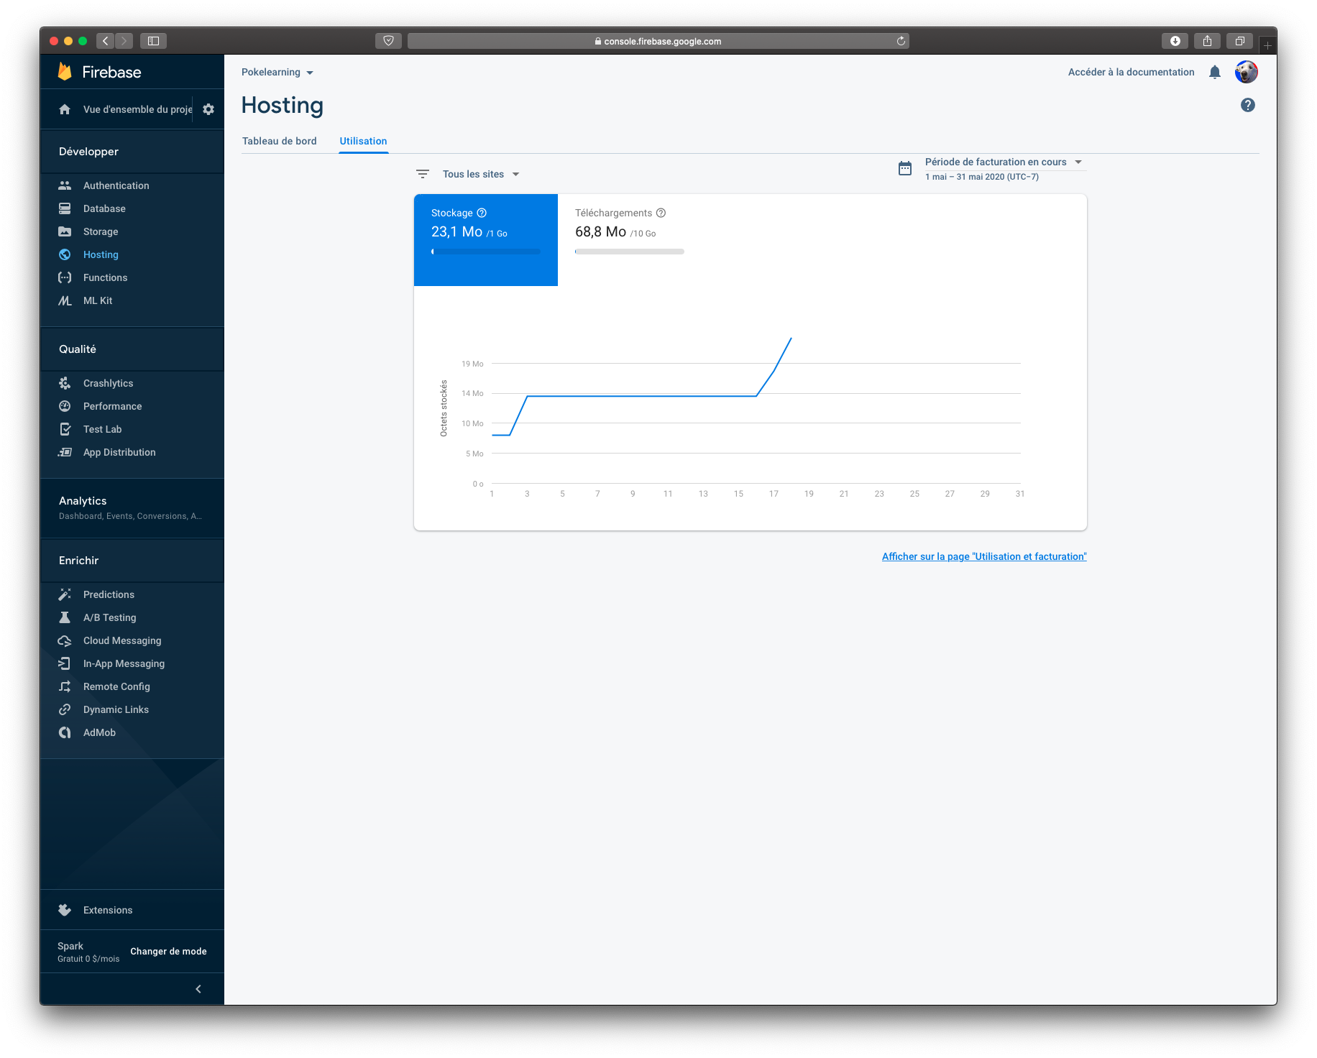
Firebase Hosting
Host Website
Offer a free domain name
Secure connection with HTTPS
Valid certificate

Slide 18

Firebase Real-time database
Centralise data of the application
All changement are on all user
Data on JSON Format
Framework for Javascript create by Google

Slide 19

03
Feedback
What to keep ?
What to change ?
What benefits ?

Slide 20
04
Conclusion

Slide 21
Key points
01
02
Accessible on any connected device
If connected once, the application is available offline
03
04
the management of adding questions is easy
Playful

Slide 22
Points for Improvement
Add further difficulty
Add performance monitoring
Questions with different difficulty for different types of users
Have a feedback per user

Slide 23
THANKS!
Do you have any questions?

